Slide 1

Metropolitan Walkability
Notes:
Welcome to Team 34's presentation investigating metropolitan walkability research. All of the necessary information will be contained on the slides themselves, but there will be a bit of a deeper dive / explanation (in paragraph structure) embedded in the "notes" section on each slide for your reference. We hope you enjoy!

Slide 2
Causal Question
Motivation • Literature • Data • Methodology • Findings • Conclusion
Does a city's walkability directly affect the health of its residents?
Is there a causal relationship between city walkability and resident health?
Do more walkable cities have healthier residents, on average, because of the greater walkability measure?
If cities are designed to be more walk-friendly in the future, will it lead to improvements in the physical health of the residents?
Notes:
The causal question that we are interested in evaluating is; does a city's walkability index score (a measure of how pedestrian- and walk-friendly the city is) have a direct impact on the physical health of its residents? Since physical health is an important indicator of quality of life, happiness, and healthiness, we are interested in whether the layout of a metropolitan area has a significant impact on the residents who live there. In a general sense, does urban design truly affect resident health? To investigate this question further, we will use the proportion of residents with obesity as our proxy for "health."

Slide 3
Motivation
Motivation • Literature • Data • Methodology • Findings • Conclusion
More than 2 in 5 U.S. adults (41.9%) have obesity
12% increase on obesity rate since 2000
$480.7 billion in direct healthcare costs in the U.S. due to chronic diseases driven by obesity and overweight
$1.24 trillion in indirect costs due to lost economic productivity
Notes:
According to the most recent Centers for Disease Control and Prevention data, the US obesity prevalence was 41.9% in 2017, compared to 30.5% in 2000. The result is that chronic diseases driven by the risk factor of obesity and overweight accounted for $480.7 billion in direct healthcare costs in the U.S, with an additional $1.24 trillion in indirect costs due to lost economic productivity.

Slide 4

Motivation
Motivation • Literature • Data • Methodology • Findings • Conclusion
Cause
Walking daily is a realizable way to keep fit
Find out whether city walkability has a direct causal impact on residents’ health
Help to guide city administrator when designing or renovating city infrastructure
pedestrian-friendliness
street connectivity
amenity layout
Aim
Future
Notes:
Meanwhile, when it comes to keeping fit and healthy, walking on a daily basis is arguably one of the most realizable ways to accomplish such a goal. In this case, we would like to analyze the effects of city walkability on public health. A positive correlation between city walkability and public health would provide guidance to city administrators when it comes to designing or renovating the city's infrastructure. Specifically, pedestrian-friendliness, street connectivity, and amenity layout are essential parameters to consider from a public health perspective.

Slide 5
Literature review: PRIOR RESEARCH
Motivation • Literature • Data • Methodology • Findings • Conclusion
1st paper: Walkability and Body Mass Index
  by Ken R. Smith, Barbara B. Brown, Ikuho Yamada, Lori Kowaleski-Jones, Cathleen D. Zick, Jessie X. Fan
Objectives: This study relates neighborhood walkability—density, pedestrian-friendly design, and two novel measures of land-use diversity—to residents' excess weight.
Methods: Gender-specific linear regressions for BMI and logistic regressions for the likelihood of being overweight and obese are estimated which include controls for individual-level age and neighborhood-level racial/ethnic composition, median age of residents, and median family income.
Results: Increasing levels of walkability decrease the risks of excess weight. Approximately doubling the proportion of neighborhood residents walking to work decreases an individual's risk of obesity by almost 10%. An increase in the proportion of residents in the neighborhood who walk to work is associated with a lower BMI and a lower risk of overweight and obesity for both men and women.
Conclusions: Walkability indicators, particularly the two land-use diversity measures, are important predictors of body weight.
Notes:
We investigated three published papers relevant to our analysis. This slide details the first paper, which looks at the relationship between neighborhood walkability and BMI.

Slide 6
Literature review: PRIOR RESEARCH
Motivation • Literature • Data • Methodology • Findings • Conclusion
2nd paper: Are People Living in Walkable Areas Healthier and More Satisfied with Life?
  by Shigehiro Oishi, Masao Saeki, Jordan Axt
Objectives: Are people who live in more walkable areas healthier and more satisfied with life? This study investigates that question.
Methods: With a cross-sectional research design and using multilevel random coefficient modeling, the authors' found that people living in walkable areas reported being generally healthier than people living in less walkable areas. In addition, aside from higher self-reported health, people living in walkable areas also had a lower body mass index (BMI).
Results/Conclusions: Using a multi-level, ecological framework the authors' examined the role of walkability of metropolitan areas in residents’ well-being—here, life satisfaction and health. As predicted, those living in walkable areas self-reported better health and lower BMIs than those living in less walkable areas.
Notes:
The second paper looked at both public health and public happiness with respect to walkability.

Slide 7
Literature review: Prior research
Motivation • Literature • Data • Methodology • Findings • Conclusion
3rd paper: Change in Walking and Body Mass Index Following Residential Relocation: The Multi-Ethnic Study of Atherosclerosis
  By Jana A Hirsch, Ana V Diez Roux, Kari A Moore, Kelly R Evenson, Daniel A Rodriguez
Objectives: The authors investigated whether moving to neighborhoods with closer proximity of destinations and greater street connectivity was associated with more walking, a greater probability of meeting the “Every Body Walk!” campaign goals (≥ 150 minutes/week of walking), and reductions in body mass index (BMI).
Methods: The authors linked longitudinal data from 701 participants, who moved between 2 waves of the Multi-Ethnic Study of Atherosclerosis (2004–2012), to a neighborhood walkability measure (Street Smart Walk Score) for each residential location. The authors used fixed-effects models to estimate if changes in walkability resulting from relocation were associated with simultaneous changes in walking behaviors and BMI.
Results: Moving to a location with a 10-point higher Walk Score was associated with a 16.04 minutes per week increase in transport walking, 11% higher odds of meeting Every Body Walk! goals through transport walking, and a 0.06 kilogram per meters squared reduction in BMI.
Conclusions: The authors' findings illustrated the potential for neighborhood infrastructure to support health-enhancing behaviors and overall health of people in the United States.
Notes:
The third paper investigates the change in walking and BMI as residents moved to different neighborhoods.

Slide 8


DATA Sources
Motivation • Literature • Data • Methodology • Findings • Conclusion
Source #1
Walkability Index Data from WalkScore Inc. ….
2020
city, state, region, walk_score, bike_score, transit_score
Source #2
American Community Survey from the U.S. Census Bureau
2016
median_age, male_pop, female_pop, total_pop, veterans, foreign_born, avg_hh_size, black, white, asian, hispanic_latino
Source #3
500 Cities: Local Data for Better Health from the U.S. CDC
2020
obesity_perc, no_exercise_perc
Source #4
U.S. City Income Data from Index Mundi …....
2020
median_hh_income
Year
Variables
Notes:
This table shows a summary of how we reached our final dataset. We began with Source #1 and added data from different sources until we felt we had compiled a comprehensive dataset that would facilitate our analysis. Our final dataset includes 20 variables (listed in the table) and 105 observations (large American cities).

Slide 9
DATA Assumptions
Motivation • Literature • Data • Methodology • Findings • Conclusion
The data collected from all 4 sources is complete and accurate
The cities' demographic proportions did not undergo any major changes across the 4-year period from 2016 to 2020
  i.e. the proportion of female / Black / Hispanic / foreign-born residents remained fairly stable over these years
The few observations with missing values were missing at random (randomly distributed across cities)
  missing data is not a result of any specific factor
  the missingness of data is unrelated to the error term, so the OLS estimators will be unbiased and consistent
Notes:
In order to move forward with our analysis, we recognized a few assumptions that were necessary to state. We assumed that our gathered data is complete and accurate, that the demographic proportions do not undergo any serious changes across the years of our data (because 3 sources had 2020 data, while the last one had 2016 as the most recent), and that the few observations which had missing values were missing at random. Therefore, we removed the observations with missing data (about 2% of the data) and ensured that this would not skew our analysis.

Slide 10

Exploratory Data Analysis
Motivation • Literature • Data • Methodology • Findings • Conclusion
We conducted extensive data exploration to familiarize ourselves with the data and observe any potential patterns or nuances
  To see how obesity (Y) relates to the independent variables (X's)
  To see if there is any heteroscedasticity or multicollinearity in the data
Notes:
The exploratory data analysis was conducted to observe how obesity percent among city residents relates to the input variables in our dataset. We also checked the credibility in terms of heteroscedasticity. In the following slides, we will go ahead and look at the visualizations for walkability, region, and household income against obesity.

Slide 11
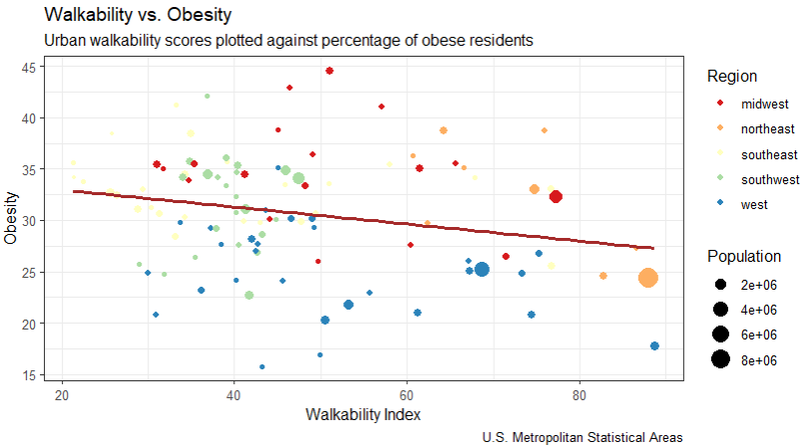
Motivation • Literature • Data • Methodology • Findings • Conclusion
This visualization depicts a weak negative relationship between walkability scores and resident obesity, shown by the downward-sloping trend line.
Notes:
Here, when we observe how obesity changes with respect to walkability index, we see a downward trend denoting that they are inversely related. In other words, the percentage of residents with obesity decreases when the walkability index of a city increases. This makes sense; we expect walkability to improve fitness and thus reduce obesity.

Slide 12
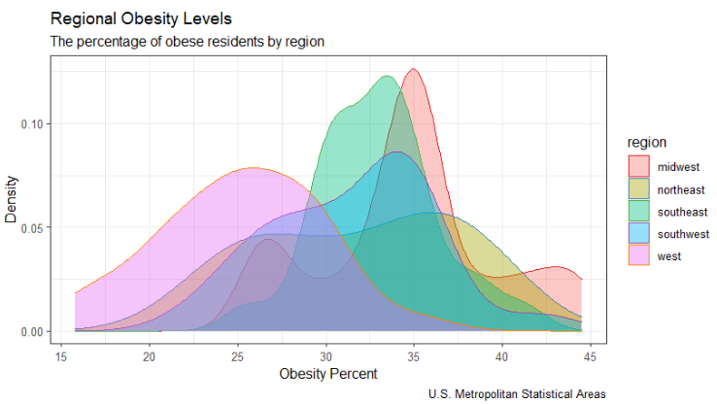
Motivation • Literature • Data • Methodology • Findings • Conclusion
This visualization shows the obesity trends by density curves for each region of the United States.
Notes:
Moving to a more geographical analysis, we observe density curves of obesity patterns by the region of the United States. The obesity rates are considerably lower in the West. The Northeast has the flattest curve, while the Midwest and the Southeast obesity percentages are much more concentrated at around 30-35 percent, respectively.

Slide 13
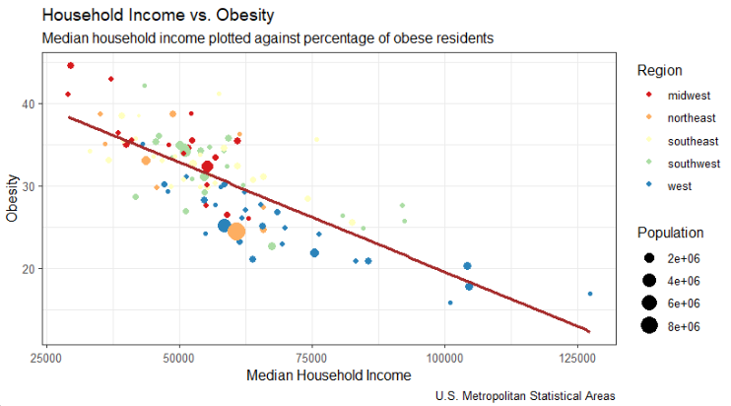
Motivation • Literature • Data • Methodology • Findings • Conclusion
This visualization shows a very clear negative relationship between obesity levels and household income.
Notes:
We can clearly see in this visualization that as the median household income increases, obesity decreases considerably at a constant rate. This can be attributed to better access to healthy food and being more nutritionally cognizant as income levels increase.

Slide 14

Methodology Overview
Motivation • Literature • Data • Methodology • Findings • Conclusion
Goal: Analyze if high walkability scores cause a decrease in the percentage of obese residents
Approach: Owing to the non-randomization selection of the treatment and the control group, we used a Difference in Difference approach to solve this problem
Control Group: 52 cities with walkability scores below the median walkability score of 43.2
Treatment Group: 53 cities with walkability scores above the median walkability score of 43.2
Using the median to split the groups: Our sample was spread quite evenly, giving us 4 neat, even partitions of the cities in the dataset
Notes:
Our goal is to check if high walkability scores cause a decrease in the obesity percentage. Here, our control group is the collection of cities with low walkability scores and our treatment is the collection of cities with high walkability scores. We set the threshold for measuring how high or low a walkability score is using the median of our 105 observations. In our case, the median walkability score was 43.2. Therefore, cities having a walkability score of below 43.2 were considered the "control" group and those above were considered the "treatment" group. Owing to the non-randomization selection of the treatment and the control group, we used a Difference-in-Difference approach to solve this problem. We used the median as the threshold, since our sample was spread quite evenly, and separating the groups according to the median gave us 4 clean, even partitions of the data. We also experimented with clustering of the data, but found that it did not give us 4 partitions as evenly distributed as the partitions created by using the median.

Slide 15
Pseudo-DID approach
Motivation • Literature • Data • Methodology • Findings • Conclusion
 | Low Obesity | High Obesity
Low Walk (Control) | Y_{LL} | Y_{LH}
High Walk (Treatment) | Y_{HL} | Y_{HH}
*where Y is the group average
Obesity Percentage
(Y_{HH} - Y_{HL}) - (Y_{LH} - Y_{LL})
We want to estimate the treatment effect as:
Treatment
Control
Notes:
Similar to how we segregated our data using the median walkability score, we set the threshold for measuring how high or low the obesity percentage is using the median obesity percentage for both the high and low walkability score groups. This in turn gave us 4 groups:
Cities with low walkability scores and low obesity percentages
Cities with low walkability scores and high obesity percentages
Cities with high walkability scores and low obesity percentages
Cities with high walkability scores and high obesity percentages
Here, we estimate the treatment effect as the difference between the treated and the control group as depicted above.

Slide 16




OLS Approach
Motivation • Literature • Data • Methodology • Findings • Conclusion
Identify relevant features that are indicators of obesity to use as controls (other than walk_score).
Identify the significant interaction terms.
Attempt regressions with the significant interactions.
Use the significant variables and the interactions to build four incrementally complex regression models.
Notes:
Using our initial exploratory data analysis, we identified significant indicators of obesity other than walk score. Building on this, we pinpointed the significant interaction terms. Out of the 18 variables, we left out any regressors that were not significant. Some of them, such as 'Bike Score' varied directly with 'Walk Score'. We excluded such regressors as they would have led to a potential Multi-Collinearity issue. After several trials, we arrived at 4 OLS models, for which we incrementally added significant variables and interaction terms.

Slide 17


IN an ideal setting...
Motivation • Literature • Data • Methodology • Findings • Conclusion
To run a true DiD analysis, we would've preferred to have balanced panel data
Obtaining the ideal data can be difficult
  Not a lot of cities have major infrastructural changes very often;
    City walkability is a fairly stable variable – doesn't vary a lot for each city over time
    Must be observed over very long periods of time (years, decades, etc.)
  If we do look at developing cities that have evolving walkability index scores;
    Sample size is not large enough
    Other features will also vary (such as population, income etc.), making it difficult to create a control group
Using a "pseudo" DiD approach was our best use of the data we compiled
Notes:
After compiling the data for this project, we ended with a comprehensive dataset of American cities – including location, walkability index and related measures, demographical information, income data, and more. However, the downfall of our dataset is that it is inherently cross sectional data. We only have one record per city – no observations of the same city over time. Having multiple records of the same city over time (ideally, a few years in between data points) would allow us to perform a true difference-in-difference analysis to determine the treatment effect. However, there are certain challenges associated with collecting this data. Most cities do not undergo major infrastructural changes very often, which would contribute to an evolving walk score. If we do look at cities that are developing and improving their walkability in the United States, we run the risk of having a very small sample size, and we must then also control for the changing demographic features of the city. With our cross-sectional data, using the "pseudo" DiD approach was the most accurate method of determining the treatment effect of city walkability on resident obesity percent.

Slide 18
THE IDEAL Methodology
Motivation • Literature • Data • Methodology • Findings • Conclusion
Need complete data of all major metropolitan cities over time
  i.e. walkability score measured every 5 years for 30 years gives us 6 points of reference for each city in the data
Assign each city into treatment and control groups
  Group assignment is based on whether the city invests heavily in pedestrian-friendliness (yes = treatment, no = control)
  Give treatment cities access to a large budget solely focused on increasing pedestrian accessibility and proximity in the city
    Includes removing zoning laws, mixing residential buildings in with commercial buildings, adding sidewalks, pedestrian/bike paths, pedestrian bridges, etc.
Run difference-in-difference analysis
  Find the difference in the before vs. after obesity percentage for both groups
  Calculate the difference between the treatment and control groups to find the estimated treatment effect
Notes:
If, hypothetically, we could access this "ideal" data, we could run a true difference-in-difference analysis. I would recommend separating the cities into treatment and control groups based on the amount of the city budget that is allocated to improving pedestrian-friendliness / walkability through urban design. There are many ways to improve a city's walk score, but most of them come down to decisions of the city planners and city council. Those cities that are deemed the "treatment" group should be given a large budget for infrastructural and zoning (residential/commercial geographical balance) improvements. We can then observe how the treatment and control groups change over time. We can calculate the "difference in differences" between the two groups' obesity percentages to arrive at the treatment effect.

Slide 19
FINDINGS – Did Analysis
Motivation • Literature • Data • Methodology • Findings • Conclusion
 | Low Obesity | High Obesity
Low Walk (Control) | 27.669 | 35.254
High Walk (Treatment) | 24.778 | 35.288
H – L = 7.585
H – L = 10.510
Estimated average treatment effect: 10.510 - 7.585 = 2.925%
Notes:
After performing the difference in difference analysis using our “pseudo"-panel data and DiD approach, we found that having a high walkability score reduces the resident obesity percentage by 2.925% on average. Recall that the "control" group is cities with low walkability indexes, and the "treatment" group is cities with high walkability indexes. All values in the table are average obesity percentage for cities in that group. We calculated this by finding the difference in obesity percentage (the dependent variable) of the control group, and then doing the same for the treatment group.

Slide 20
FINDINGS – OLS models
Motivation • Literature • Data • Methodology • Findings • Conclusion
Ran a series of 4 different OLS regression models of obesity percentage on walkability score
  Incrementally added control variables
  Removed variables that exhibited multicollinearity
    "South" region, "bike_score" (highly correlated with walk_score)
  Included significant interaction terms
All regression outputs reported in stargazer table
stargazer table on next slide
Notes:
We ran 4 OLS models to determine the treatment effect using a different method. Each model progressively adds control variables. We were selective about the regressors included in these models – avoiding multicollinearity situations and being sure to include variables that make sense in the context of the causal problem. We removed one of the regions in order to avoid perfect multicollinearity and we left out "bike_score" because it is heavily correlated with the independent variable of interest. Many of these decisions were based on our extensive EDA, which is further detailed in the R code file.

Slide 21
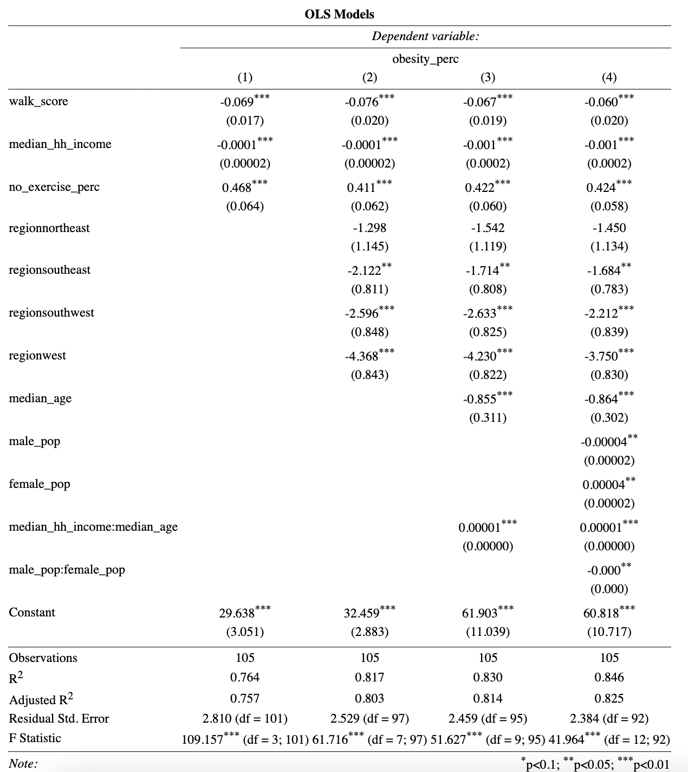
FINDINGS – OLS MODELS
Motivation • Literature • Data • Methodology • Findings • Conclusion
Regression (4) provides the most accurate estimate for the treatment effect of walkability on obesity
  Includes many significant controls
  Includes two significant interaction terms
The adjusted R² value of 0.825 in regression (4) indicates that about 82.5% of the variance is explained by the controls in the model
Regressions (1) and (2) are most likely overestimates
Notes:
The stargazer table simply depicts the outputs of the 4 incremental regressions. The most accurate estimate for the treatment effect of interest in our analysis is presented by regression (4) on the table. This model provides the most significant controls and explains the greatest amount of variance in the dependent variable, percent of residents with obesity. As the models get progressively more complex, we can see how the coefficient of walk_score (the treatment effect) gets pulled down. Using a model with very little controls tends to overestimate the treatment effect. We also have to be cognizant of the possibility of omitted variable bias – neglecting to include a relevant regressor in the model. In this context, it does not appear to be a problem plaguing the models.

Slide 22
FINDINGS – Comparison
Motivation • Literature • Data • Methodology • Findings • Conclusion
Living in cities with high walkability is associated with a ...
pseudo-DiD approach: 2.9%
OLS models: 6.0%
… decrease in the proportion of residents who have obesity.
vs.
Prior literature: Living in more walkable areas is associated with lower BMI, higher life satisfaction, more exercise, and lower risk for obesity,
Notes:
After performing the difference in difference analysis using our “pseudo"-- DiD, we found that having a high walkability score reduces the obesity percentage by 2.925% on average. With our OLS, we found this value to be about 6.0%. From these studies, we can conclude that having higher walkability score does indeed reduce the obesity percentage in a city. We can further extent this to say that having a higher walkability score improves the overall health of the city as we used obesity percentage as a proxy for healthiness. This is consistent with our literature review which concluded that living in more walkable areas is associated with lower BMI, higher life satisfaction, and lower risk for obesity.

Slide 23
CONCLUSION
Motivation • Literature • Data • Methodology • Findings • Conclusion
Compiled a comprehensive dataset of large metropolitan cities in America
  Exploratory data analysis
Used a pseudo-DiD approach to calculate the treatment effect of high city walkability on obesity percentage
Ran many OLS regressions with varying regressors as controls
  To determine the quantitative effect of walkability index on obesity percentageEval
  Using relevant independent variables and interaction terms
Made many procedural decisions about the best method
  How to split treatment and control groups, which controls to include, how to handle cross-sectional data, which model best captures the true effect
Notes:
In conclusion, we discovered that there does appear to be a causal effect of walkability on obesity levels. Cities with higher walkability scores consistently report lower levels of obesity. In addition, both methods that we employed – pseudo-DiD and OLS models – to get to our desired treatment effect found a statistically significant negative relationship between walkability index and percent of residents with obesity in a city. Our findings are consistent with the prior literature. The findings are promising and indicate to urban developers that there are important ideas to consider with urban design, such as residential-commercial proximity and pedestrian-friendly design. The layout of a metropolitan area certainly has an effect on the health of the residents who live there.

Slide 24

References
Motivation • Literature • Data • Methodology • Findings • Conclusion
“Adult Obesity Facts.” Centers for Disease Control and Prevention, Centers for Disease Control and Prevention, 17 May 2022. www.cdc.gov/obesity/data/adult.html.
Jana A. Hirsch, Ana V. Diez Roux, Kari A. Moore, Kelly R. Evenson, Daniel A. Rodriguez. "Change in Walking and Body Mass Index Following Residential Relocation: The Multi-Ethnic Study of Atherosclerosis". American Journal of Public Health, 2014. 104, e49_e56, https://doi.org/10.2105/AJPH.2013.301773
Ken R. Smith, Barbara B. Brown, Ikuho Yamada, Lori Kowaleski-Jones, Cathleen D. Zick, Jessie X. Fan. "Walkability and Body Mass Index." American Journal of Preventive Medicine, 2008. Volume 35, issue 3, p237-244. https://doi.org/10.1016/j.Amepre.2008.05.028
Oishi, S., Saeki, M., Axt, J.. "Are People Living in Walkable Areas Healthier and More Satisfied with Life?." International Association of Applied Psychology: Health and Well-Being, 7: 365-386. https://doi.org/10.1111/aphw.12058
Park, Sohyun. “Overweight & Obesity Statistics.” National Institute of Diabetes and Digestive and Kidney Diseases, U.S. Department of Health and Human Services, Sept. 2021. www.Niddk.Nih.Gov/health-information/health-statistics/overweight-obesity.
Waters, Hugh. “America's Obesity Crisis: The Health and Economic Costs of Excess Weight.” The Milken Institute, 22 Sept. 2020. www.milkeninstitute.org/report/americas-obesity-crisis-health-and-economic-costs-excess-weight.
Notes:
The references here show a list of all the sources used to conduct our analysis. Thanks for reading!

